Slide 1
Stochastic Recursive Gradient Descent
By: Preston Robertson
Notes:
Introduce ourself, what we do and the department

Slide 2
Overview
2
Objective: Learning a modern implementation of the stochastic gradient descent.
Overview:
Neural Network Learning
Stochastic Gradient Descent
Updates to Stochastic Gradient Descent
Stochastic Recursive Gradient Descent
Literature
Notes:
Ask them to tell us in their own words what AM
History

Slide 3
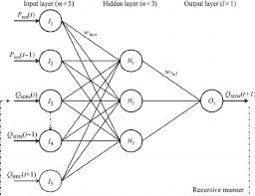
Neural Networks Learning
3
Why: Neural Networks learn in order to solve supervised learning problems. How: The neural network learns through a combination of back-propagation and stochastic gradient descent.
Back-propagation: Taking the error in the final layer and propagating that error through each layer of the neural network.
Notes:
Ask them to tell us in their own words what AM
History

Slide 4
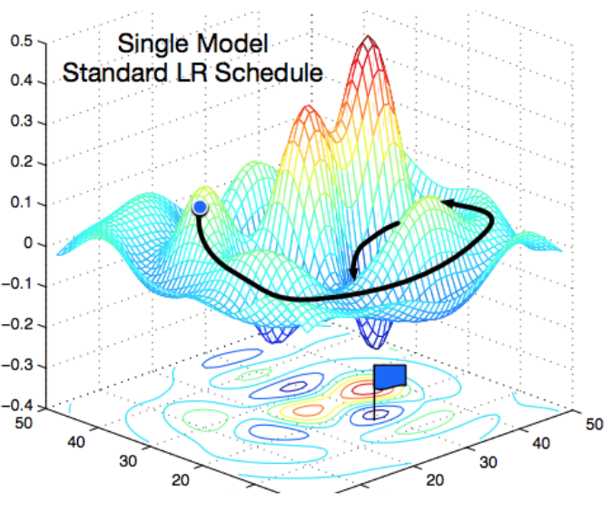
Stochastic Gradient Descent
4
Why: Optimizing the neural network.
What: Updating the weights and biases to have the optimal output of the neural network.
How: Through finding the derivative of all weights and biases with respect to the loss, it is possible to take the gradient and find the local/global minimum loss given each weight and bias.
Notes:
Ask them to tell us in their own words what AM
History

Slide 5
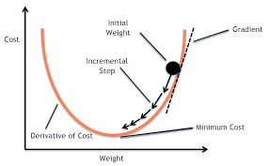
Updates to SGD
5
Why: The original SGD method is not the perfect way to optimize the neural network and has problems of its own.
Momentum Based Learning: SGD can be a slow process that takes several epochs. MBL tries to mitigate this downside by speeding up the descent if it is going in a continuous direction.
Constant Step Size: The SGD can have a limited step size to keep from getting trapped in what is the local minimum but not global minimum.
Several more…
Notes:
Ask them to tell us in their own words what AM
History

Slide 6
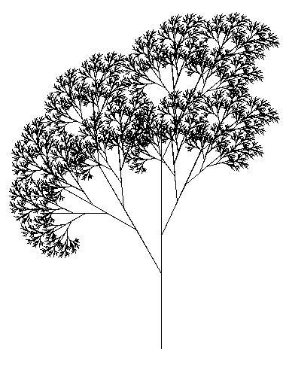
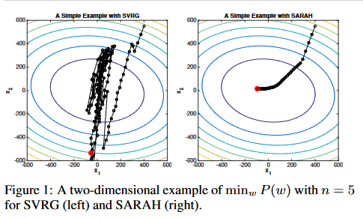
Stochastic Recursive Gradient Descent Algorithm (SARAH)
6
Why: To find a way to optimize solutions faster
Recursion: Relating to or involving a program or routine of which a part requires the application of the whole, so that its explicit interpretation requires in general many successive executions.
What: The algorithm considers all previous points and iterates across all to determine the global minimum.
How: By finding several different local minimums in each iteration, effectively grid searching, it is easier and faster to find the global minimum.
Notes:
Ask them to tell us in their own words what AM
History

Slide 7
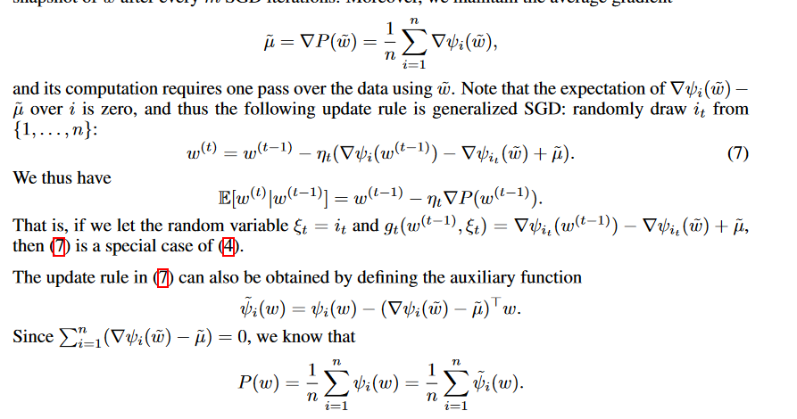
Literature: Understanding the Math
7
Paper 1: Johnson, R., & Zhang, T. (2013). Accelerating stochastic gradient descent using predictive variance reduction. Advances in neural information processing systems, 26.
Paper 2: Roux, N., Schmidt, M., & Bach, F. (2012). A stochastic gradient method with an exponential convergence _rate for finite training sets. Advances in neural information processing systems, 25.
Paper 3: Nguyen, L. M., Liu, J., Scheinberg, K., & Takáč, M. (2017). Stochastic recursive gradient algorithm for nonconvex optimization. arXiv preprint arXiv:1705.07261.
Paper 4: Kasai, H., Sato, H., & Mishra, B. (2018, July). Riemannian stochastic recursive gradient algorithm. In International Conference on Machine Learning (pp. 2516-2524). PMLR.
Notes:
Ask them to tell us in their own words what AM
History

Slide 8
Questions?
Contact Information:
Email: pgr41@msstate.edu
Comment under this video
Or message me on Canvas
Notes:
Ask them to tell us in their own words what AM
History

Slide 9
References
Objective:
…
Method:
…
Set-up:
…
Conclusion:
…
Discussion:
…
Notes:
Ask them to tell us in their own words what AM
History

Slide 10
Steps to Stochastic Recursive Gradient Descent
2
Recursion: Relating to or involving a program or routine of which a part requires the application of the whole, so that its explicit interpretation requires in general many successive executions.
Momentum Based Learning:
Iterate Averaging:
Constant Step Size:
Notes:
Ask them to tell us in their own words what AM
History

